Slide 1
Arno Rosemarin Simon Okoth Stockholm Environment Institute PAB Meeting Seattle 23 Oct 2017
Project Overview:
Objectives & Deliverables
www.susana.org
www.forum.susana.org

Slide 2
Project has 3 main outcomes
Improved use of SuSanA Platform by identified target groups, through a clear communications plan and platform improvements.
Demonstrable improvements in the impact that use of the SuSanA Platform has on members’ work in sanitation.
Strengthened governance and institutional sustainability of SuSanA as reflected in an operational plan that includes a plan for funding the budget needed to assure the future of SuSanA

Slide 3
Deliverables year 1
Market study
Focus on global south stakeholders
Personas model
SWOT analysis
M&E (KPIs)
Communications strategy
Implementation plan

Slide 4
Deliverables year 1 (cont’d)
Completed UX (user experience) study by Bentley Univ on www.susana.org & www.forum.susana.org
Both websites revamped
Search functions revamped
Curated content linked to projects & thematic areas increased
Web analytics being monitored to measure impact
UX study to be repeated in year 2 to measure impact
M&E programme with KPIs set up

Slide 5
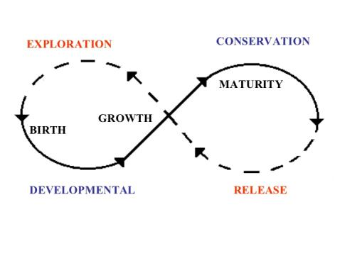
A strengthened SuSanA
Organizational Study 2018
Governance structure
Organization structure
Decision-making processes
Financial viability and sustainability
Secretariat’s capacity

Slide 6
The View from the Helicopter
a. What problems are we trying to solve? b. What have we done to solve them? c. What did we learn thus far? d. How does this inform the situation? e. What is our statement going forward?

Slide 7
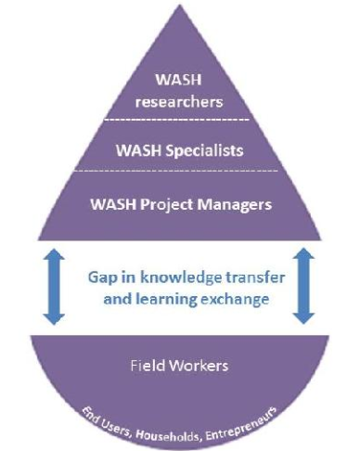
What problems are we trying to solve?
2.5 billion lack basic sanitation (1 billion of these are open defecators)
an additional 2 billion lack safe sanitation services
More specifically related to the BMGF project
KM challenge of the sector
Demand-driven curation of knowledge from the stakeholders is missing in the sector

Slide 8
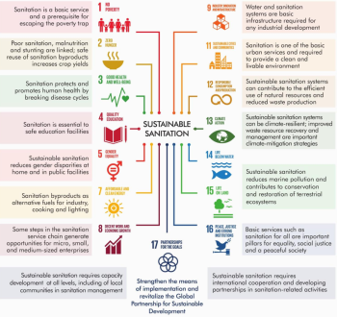
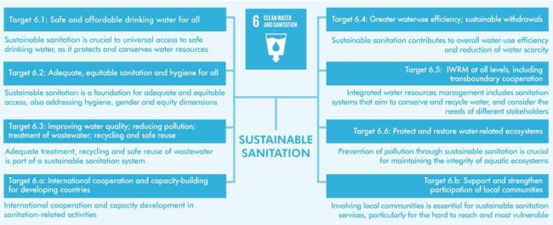
What have we done to solve it ?

Slide 9
What have we done to solve it ?
SuSanA has attracted 9000 sanitation experts & is growing
How do we leverage that expertise to promote more sustainable sanitation for all?

Slide 10
What did we learn thus far?
You can’t work just at the level of SDG6
The sector isn’t set up to work together toward SDG6
SuSanA has a strategic catalytic role in the sector as convener and curator
SuSanA has strengths and weaknesses
Our KM supply has to keep up with the sector’s demands

Slide 11
How does this inform the situation?
We begin to see the gaps in the SDG6 ecosystem
Two under-represented stakeholders in our Market Study
Government officials
Private sector
We begin to see the need to work from our Core Strengths
Find ways of addressing gaps in the SDG6 ecosystem
Integrated approaches required
In-country collaborative facilitation

Slide 12
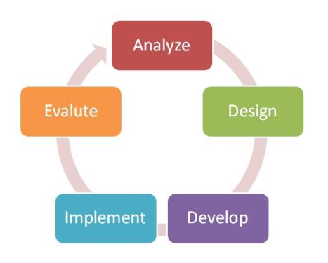
What is our statement going forward?
We are more clear on:
What SuSanA is and isn’t
What stakeholders in the sanitation sector want and need
We plan to:
Target better our efforts
Explore the potential of “Personas”
Increase the impact of our work
Intensify collaborative partnerships
Re-position SuSanA in the global SDG context

Slide 13
Elements of an Action Plan
Facilitate curation
Catalyze global consensus-building
Facilitate south-south collaborations within a global framework
Re-engineer structure of the SuSanA Working Groups
Improve cross-sectoral SDG collaboration

Slide 14
Market Survey
Question:
What are the right KM products and services for each “persona” and how should we organize ourselves for those curation tasks?

Slide 15
Financial Stakeholders
Question:
How can SuSanA help bridge that information gap between projects in need of funding and those who make financing decisions (foundations, donors, banks, government decision-makers) who want more information about the ROI potential of sanitation investments?

Slide 16
SuSanA IT Platform
Question:
What options do we have that might allow expansion of our sub-contracted IT services and at the same time enable the website to collect data on its users to continuously improve the data we have on each of the “personas”?

Slide 17
In-Country Activities
Question:
How can SuSanA, or the sector, address the need to convene local planning and coordination workshops globally and create more independence and ownership in the South?

Slide 18
Project Database & Case Studies
Question:
How can we engage thousands of “field workers” in writing up their results so other people can learn from their experience, or should we instead budget for writers to do some of this important KM work?

Slide 19
Public Education Initiative
Question:
Should SuSanA recognize the public (including journalists, household decision-makers, local government decision-makers) as one of its stakeholder groups, and what infrastructure would the Secretariat need to monitor and manage that work?

Slide 20
Private Sector
Question:
What does SuSanA, or the sanitation sector, need to offer the private sector to get them engaged with solving sanitation problems and achieving SDG6?

Slide 21
Advocacy with Government Entities
Question:
Can SuSanA leverage its convening power and the expertise of its members to benefit local decision-makers, while providing a global platform to which local actors will want to contribute?

Slide 22
Working Groups
Question:
How can we use large Working Groups to structure the curation work, create smaller teams of 5-10 people and utilize the expertise of members to maximize SuSanA’s contribution to the SDGs?

Slide 23
Capacity of the Secretariat
Question:
What management structures and infrastructure support will be needed to assure the growth of SuSanA services and at the same time assure sustainability?

Slide 24
Esther Shaylor October 2017
An Overview of Oxfam’s work with the SuSanA Consortium
www.susana.org

Slide 25
How Oxfam has thus far collaborated with SuSanA
WG support and engagement
Content contribution and creation
In-country outreach (Zambia)
Wikipedia Edit-a-thon
External representation at conferences and networking oppertunities

Slide 26
What we have learnt about engagement with Country Programmes
The greatest impact SuSanA can have is on national staff
We cannot access them through the UK based advisers and remote support staff
Need to utilise other outreach modalities; for example the Oxfam newsletter. By increasing the readership of this it will give a platform for national programmes to showcase their work and demonstrate how SuSanA can support sanitation work (now in mailchimp format for that reason). There has been a lot of comments that it is nice to see what other Oxfam programmes/countries/affiliates are working on.
Need to Understand multi media forms of engagement (eg developing podcasts) and how these can reach/influence country programmes

Slide 27
What we have learnt about engagement with the Emergency WASH sector
By nature they are often traveling with very limited internet access, therefore need to understand what services they NEED to do their job better
The easiest time to approach Emergency WASH personnel is at the WASH cluster and Environmental Health Forum (EHF) the annual key meeting
Through Oxfam SuSanA will be represented at the WASH cluster TWG in January and WASH cluster/EHF in March. This will be an opportunity to find out what organisations and practitioners need from an online platform
Oxfam will also explore services emergency practitioners highlight as key and if SuSanA is the right platform via one to one consultancy with practitioners

Slide 28
What we have learnt about supporting practitioners priority areas in-country
The Zambia in-country event was welcomed by the local practitioners, however the challenge has been the longer term support through SuSanA and engaging members beyond the physical event.
There needs to be a longer term framework for in-country activities for full support by SuSanA and a way to target the country in follow up events.
Both WaterAid and Oxfam have key programmes in Bangladesh (both emergency and development) if we target this for the next in-country event with a better strategy for long term engagement and follow up as well as key outputs we can further test the in-country approach
Key outputs could include; a country database of resources and organisations hosted on SuSanA, webinars addressing key gaps, in-country SuSanA reps. That coordinate and communicate with parties fro ongoing support

Slide 29
Arno Rosemarin PhD Stockholm Environment Institute PAB Meeting Seattle 23 Oct 2017
Market Survey
Communications Plan
www.susana.org
www.forum.susana.org

Slide 30
Components of the Market Survey
KM user survey sent to several mailing lists (30000 emails), newsletters, listserv, professional networks (total reach 50K)
3000 returns; half were SuSanA members (15% participation)
Structured interviews 40 individuals
Comparative survey of 120 WASH KM platforms/networks
Mapping of 50 organisations that specialise in KM surrounding SDG 6 and those for other associated SDGs
SWOT analysis
10 target groups defined (Personas)
Performance measurement system developed for SuSanA

Slide 31
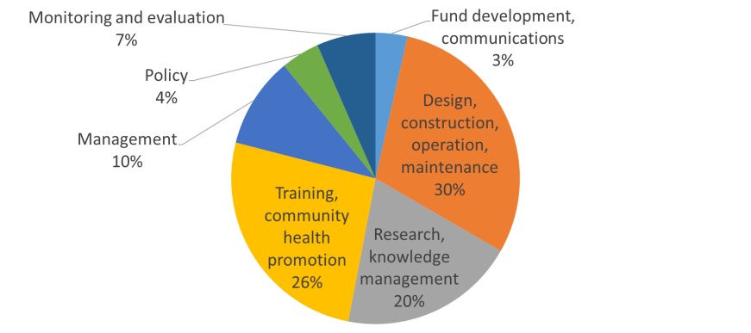
Type of work

Slide 32
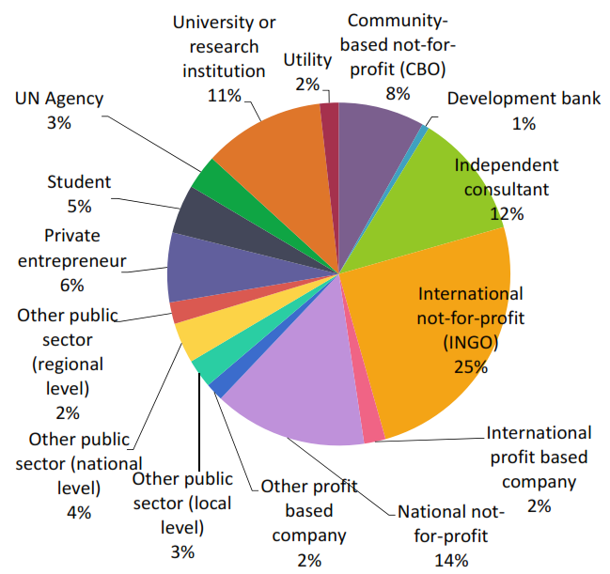
Type of organization

Slide 33
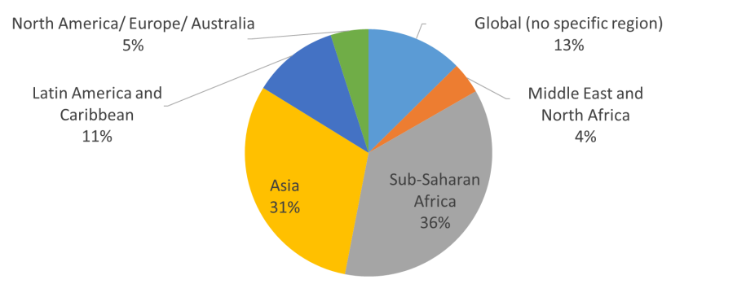
Location of work

Slide 34
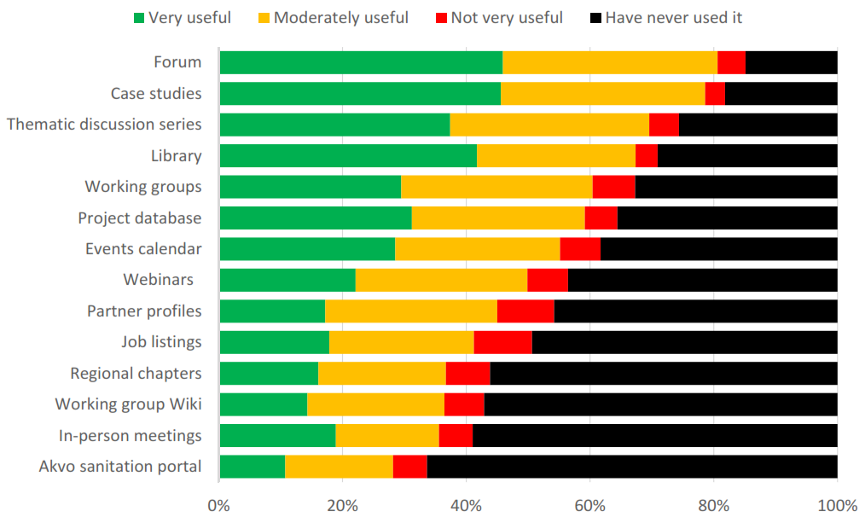
Use and usefulness of SuSanA

Slide 35
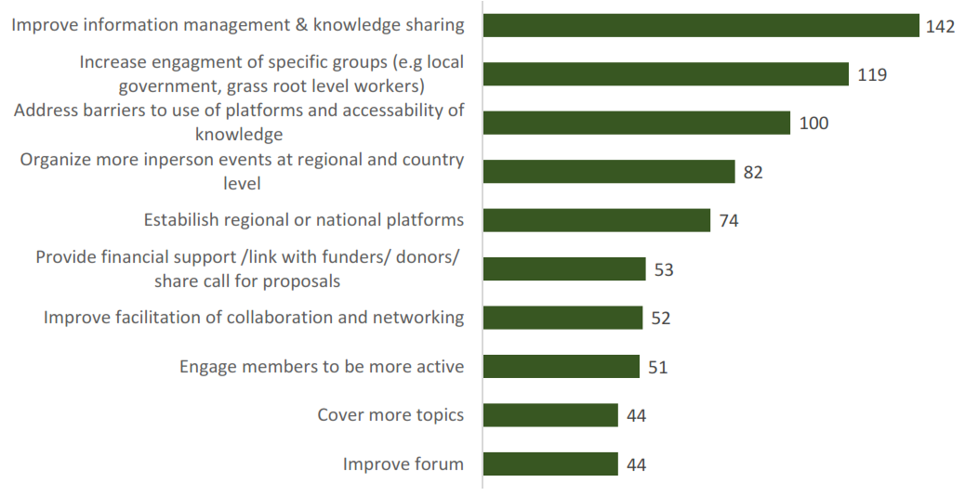
How to improve SuSanA

Slide 36
Communications Plan
SuSanA’s five guiding communications objectives
Position SuSanA within the global sanitation sector
Facilitate scaling up of sanitation through targeting of a critical mass of larger implementing agencies and national institutions
Achieve the SDGs through targeting of grassroots stakeholders in under-served areas, overcoming language barriers and the digital divide
Increase the targeted usability and relevance of the content/tools
Ability to foster collaboration among members, who contribute time and knowledge
Inspire innovative solutions by connecting to new partners and technologies

Slide 37
Priorities for implementation
Working Group engagement (including facilitation of webinars, thematic discussion series and project case studies)
Curation work including projects, reports, meetings, discussion threads, project news
in-country activities: face-to-face and online meetings in the Global South
implementation of the persona-concept on the SuSanA website, and related outreach activities
outreach activities involving SuSanA partners, private sector and donors
target group-oriented online activities (i.e. Forum moderation, thematic discussions, webinars and Wikipedia work)
alignment with strategic partners eg AfricaSan, SacoSan, LatinoSan, organisations - WSSCC, GWP, IRC, IWA, RWSN, UNESCO-IHE, etc.
project management and financial steering
project monitoring and evaluation using the new KPI system supplied by CAWST as part of the Market Survey work

Slide 38
SDG 6 market network
larger goal of making an impact on scaling up sanitation
through increased knowledge management, capacity building, financing and implementation
SuSanA and partners need
a sophisticated platform including
more think tank and face to face meetings
more powerful online services with member profiles (personas)
more sophisticated curation profiles with updated user fingerprints
new functions surrounding project development, capacity building, training and implementation, funding mechanisms (loans, bonds, trust funds, grants, etc.)
Twinning mechanisms can be developed between currently funded projects/organizations e.g. FSM Toolkit, DASRA, RTI-STEP, SanMark
Discussions with Sphaera (www.sphaera.world) re global marketplace for the sanitation sector

Slide 39
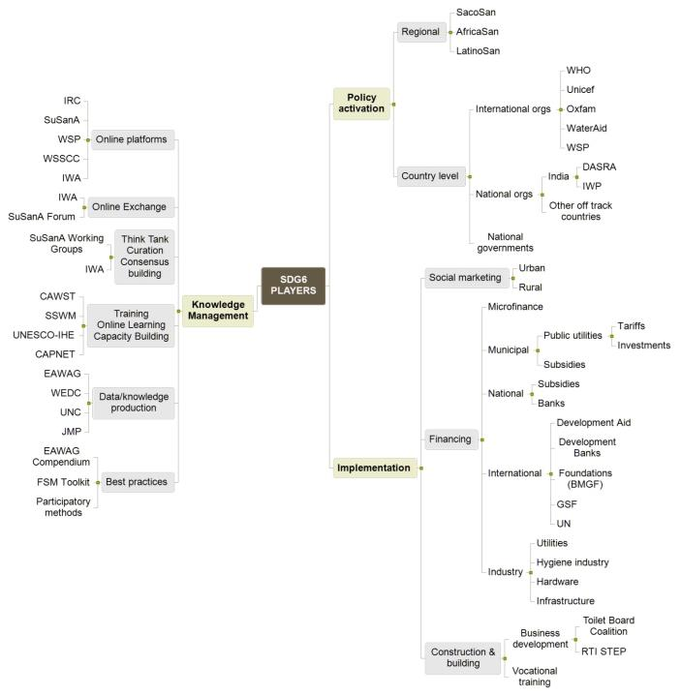
Initial
mapping of
SDG6 players

