Slide 1
5. SuSanA Partner Organisations
Partner Mapping

Slide 2
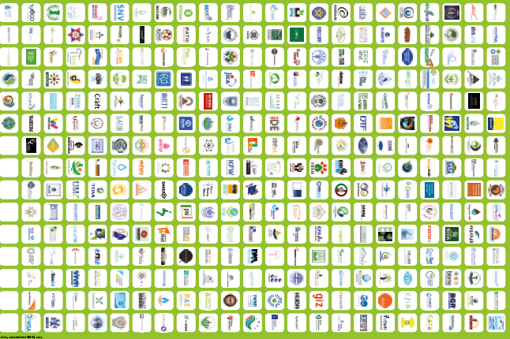
SuSanA partner organisations
353 on October 2019
Please find the latest SuSanA Partner
Roll-Up here: https://www.susana.org/en/knowledge-hub/resources-and-publications/library/details/1532
Notes:
Number of members and logos (manually) updated 23 Aug. 2012

Slide 3
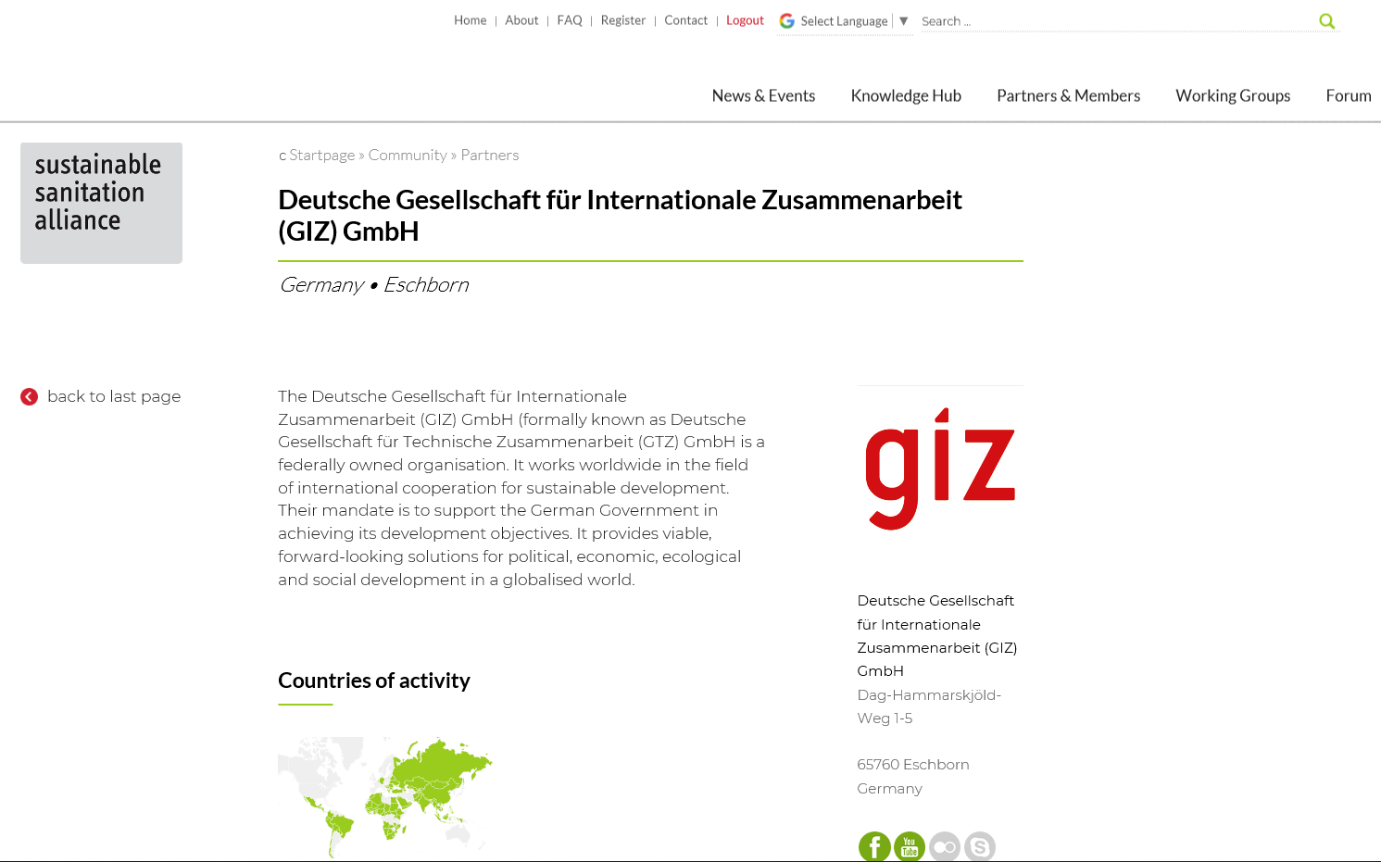
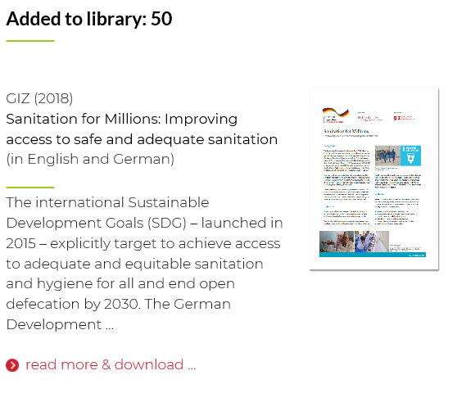
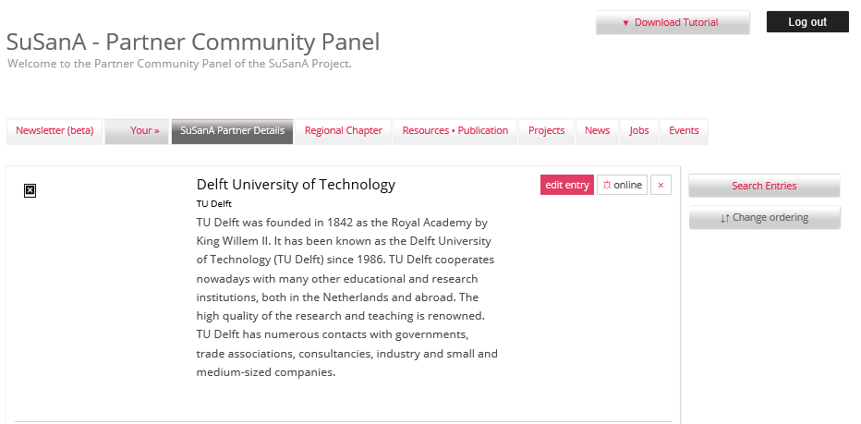
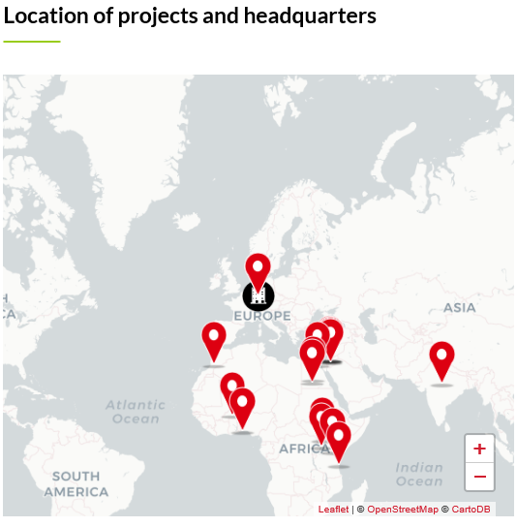
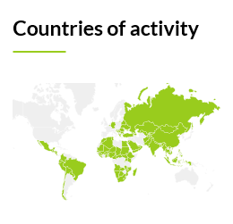
SuSanA Partners – Our Strength
Library entries
October 2019
Notes:
Encourage our partners to build the database and share information on their experiences, lessons learnt

Slide 4
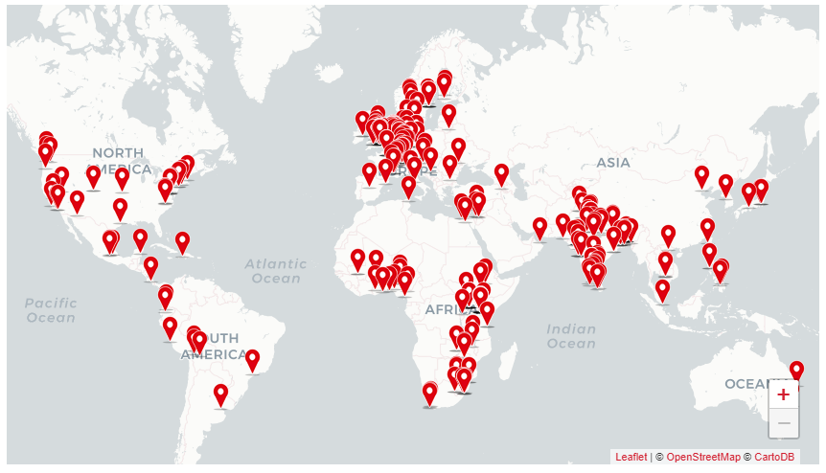
Distribution of SuSanA partners worldwide
August 2018
Notes:
Diverse – encmpasses all regions globally.

Slide 5
Distribution of SuSanA partners by region*
Date: 9 October 2019
Source: Excel Sheet SuSanA partners
*Headquarters
Notes:
5

Slide 6
Distribution of SuSanA partners by category
Date: 9 October 2019
Source: Excel Sheet SuSanA partners
Notes:
6

Slide 7
Evolution of partner organisations per year
Date: 25 November 2019
Source: Excel Sheet SuSanA partners
Notes:
7
Updated 04.06.2014

