Slide 1
9. Shit Flow Diagrams (SFDs)

Slide 2
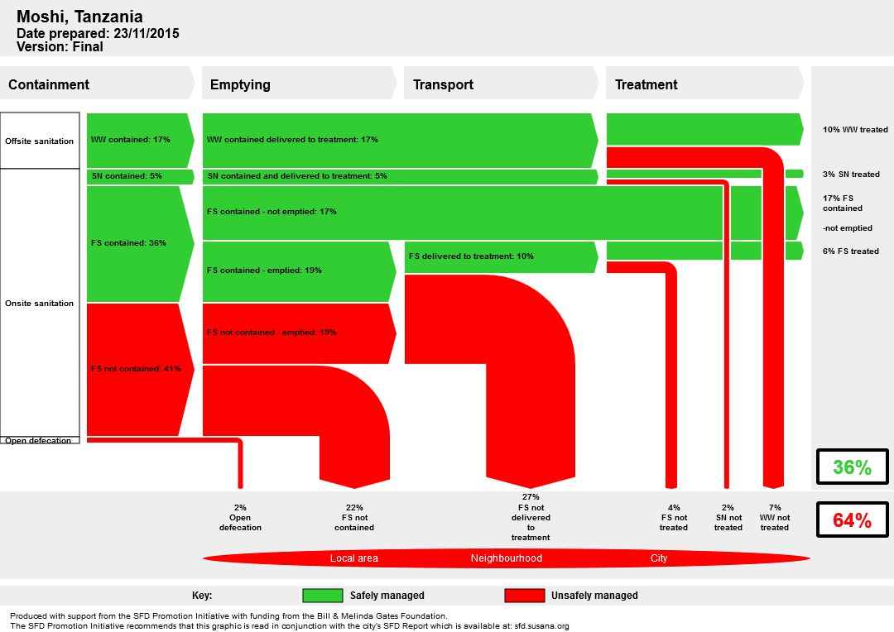
Shit Flow Diagram (SFD) – What is it?
An effective communications and advocacy tool
A tool for engineers, planners and decision-makers
Based on contributing populations and an indication of where their excreta goes
A representation of public health hazard
An overview from which to develop sanitation priorities

Slide 3
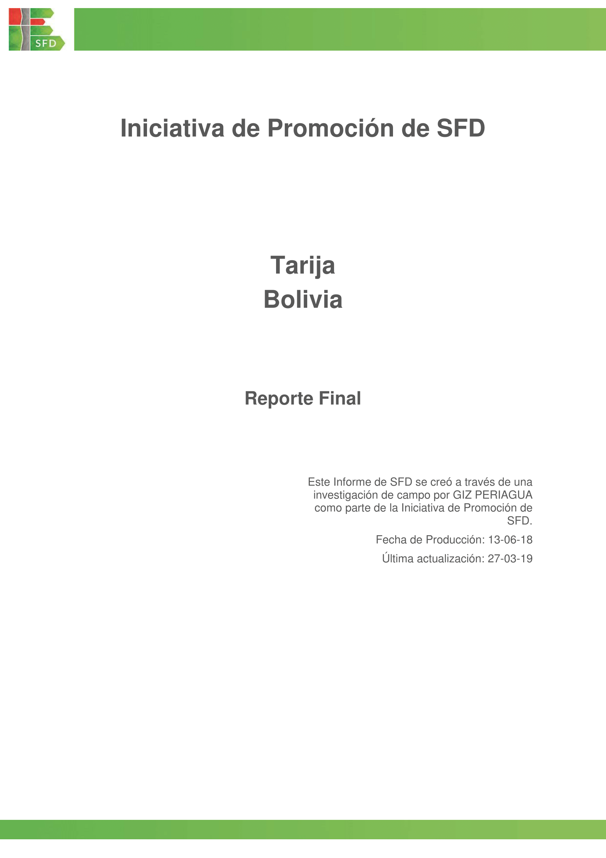
Shit Flow Diagrams (SFDs) – What is it?
A graphic that shows the pathways from defecation to final fate
A concise narrative report on the service delivery context
A complete record of all the data sources

Slide 4
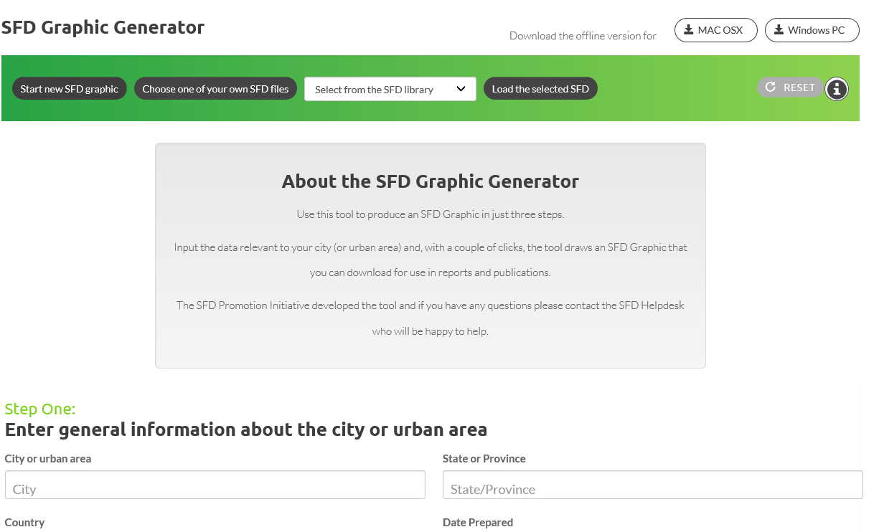
Shit Flow Diagrams (SFDs) – The Graphic Generator
Use this tool to produce an SFD Graphic in just three steps
Input the data relevant to your city to create an SFD Graphic for use in reports and publications
Can be used online and offline
https://sfd.susana.org/data-to-graphic

Slide 5
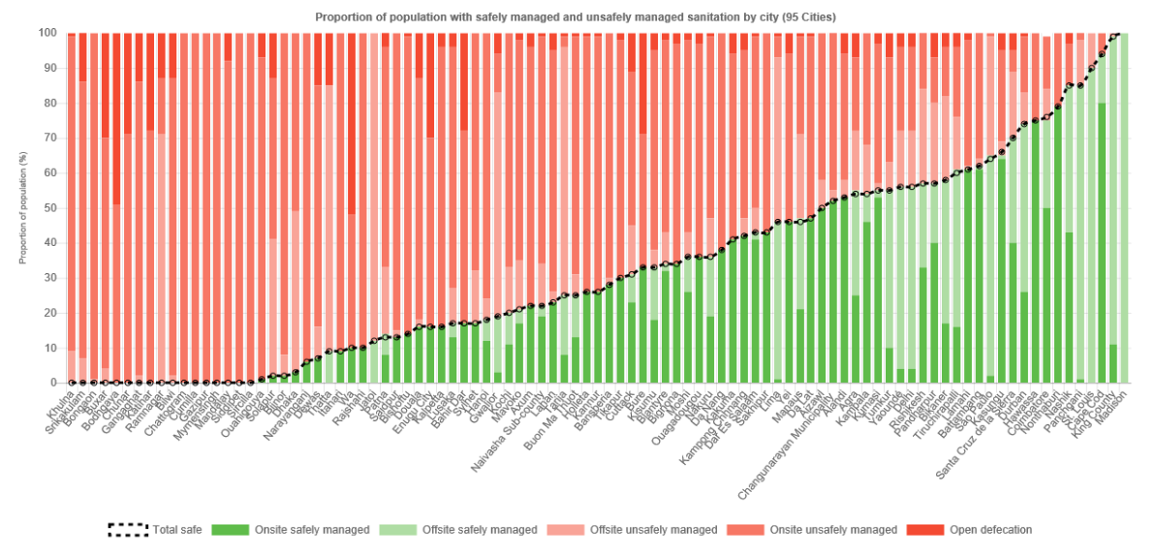
Shit Flow Diagrams (SFDs) – SFD Data
View graphs showing compiled data from all the cities where an SFD has been produced and reviewed
See the status of SFD production by region
Find SFD Reports and SFD Graphics for any city where an SFD has been produced and reviewed
https://sfd.susana.org/about/sfd-data

